Slide 1
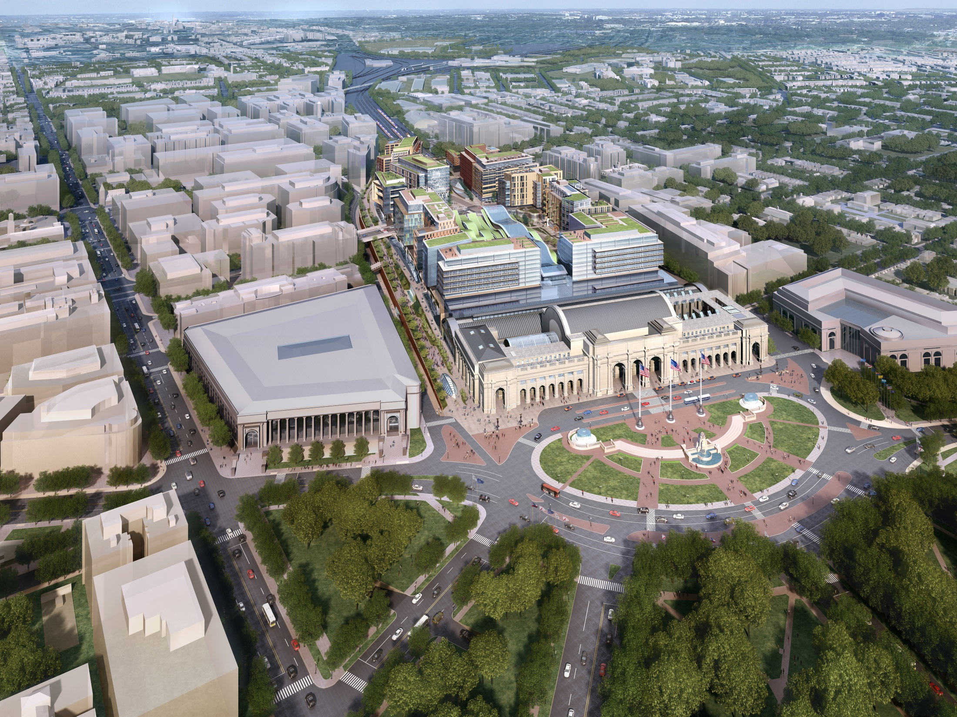
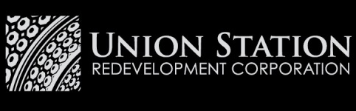

Washington
Union Station’s
2nd Century
Prepared for:
Lambda Alpha International
April 25, 2015
Washington
Union Station’s
2nd Century
2014 Annual
Stakeholder Update

Slide 2
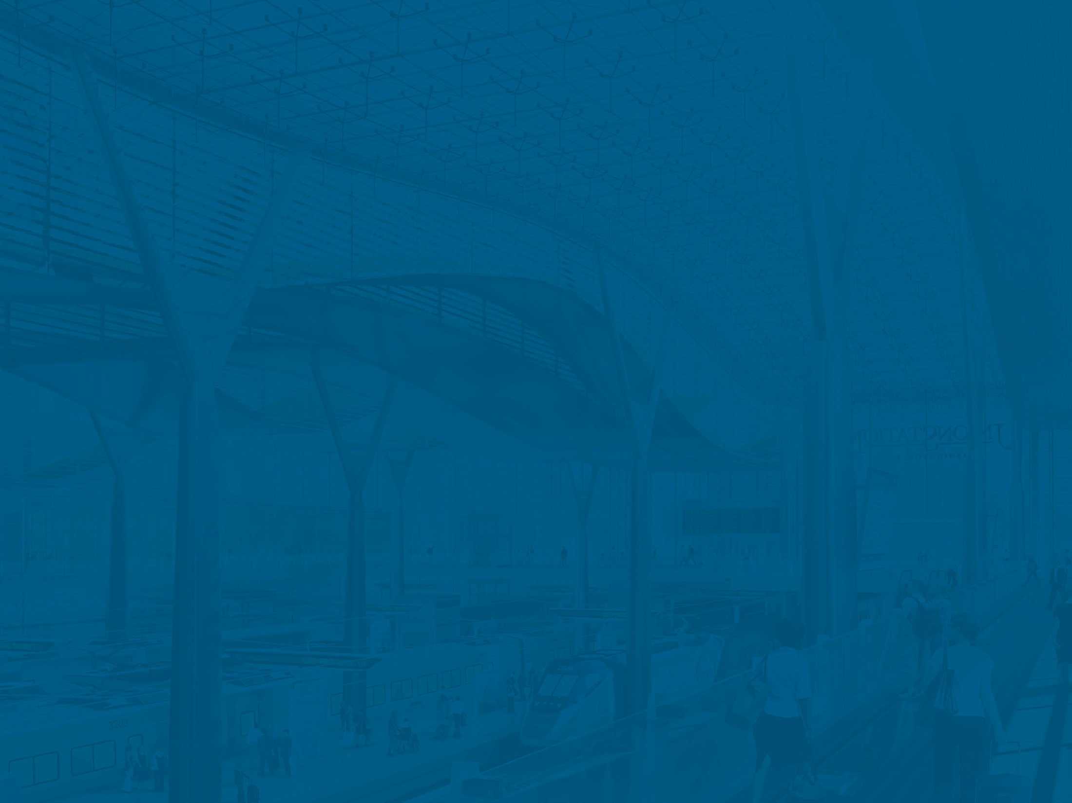
Washington Union Station’s 2nd Century
Introduction

Slide 3
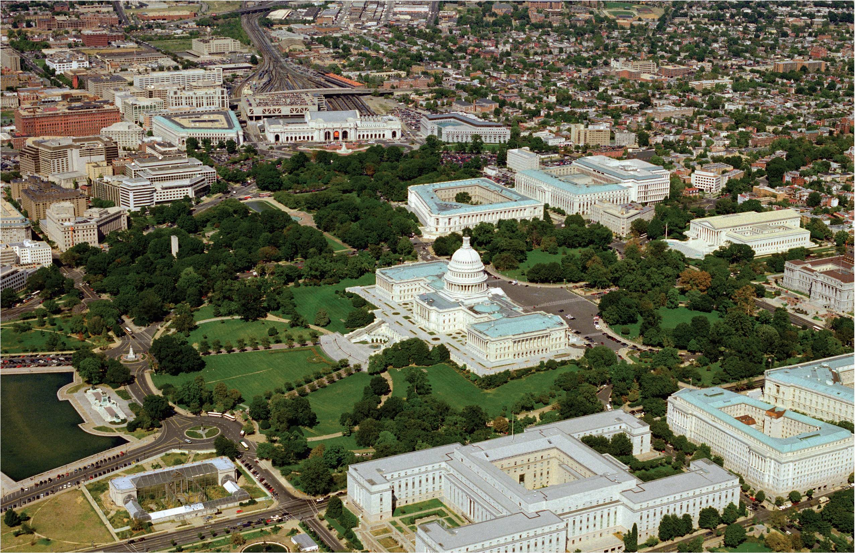
Gateway to the Nation
Historic National Treasure
Retail Activity Center
Regional Transit Center
Prominent Location on Capitol Hill
Regions “4th Airport”
serving more people daily
than BWI, Reagan, or Dulles
Notes:
Introduction to Union Station
Historic National Treasure
Retail Activity Center
Regional Transit Center
Regions “4th airport” – serves more people on a daily basis than BWI, Reagan, or Dulles
Majestic Location on Capitol Hill

Slide 4
Union Station Redevelopment Corporation (USRC)
Founded in 1983 as stewards of the Station, entrusted to protect the station’s history while developing its future.
Board of Directors
Station Stewardship
USRC
Est. 1983
by USDOT
501c3
Federal City Council
Federal Railroad Administration
US Dept. of Transportation
(Chair)
Amtrak
District of Columbia
Mayor
Notes:
Introduction to USRC
A 501 c3 Non-Profit in DC
Board of Directors
Stewards of the station – Protecting it’s history while developing it’s future.
Honoring the historic monument, ensure it’s continued function as a transportation center and commercial complex.

Slide 5
Organizational Roles
Union Station Redevelopment Corporation (USRC) – Nonprofit station complex landlord and public steward
Amtrak – Intercity and commuter rail infrastructure owner and operator
Akridge – Owner/developer of air rights project (Burnham Place)
MARC and VRE – Maryland and Virginia commuter rail providers
WMATA – Subway station and red line owner and operator
DDOT – Coordinator of surface transportation elements
Ashkenazy (Union Station Investco) – Leaseholder of all retail and restaurant spaces in the station
Notes:
Lots of players involved

Slide 6
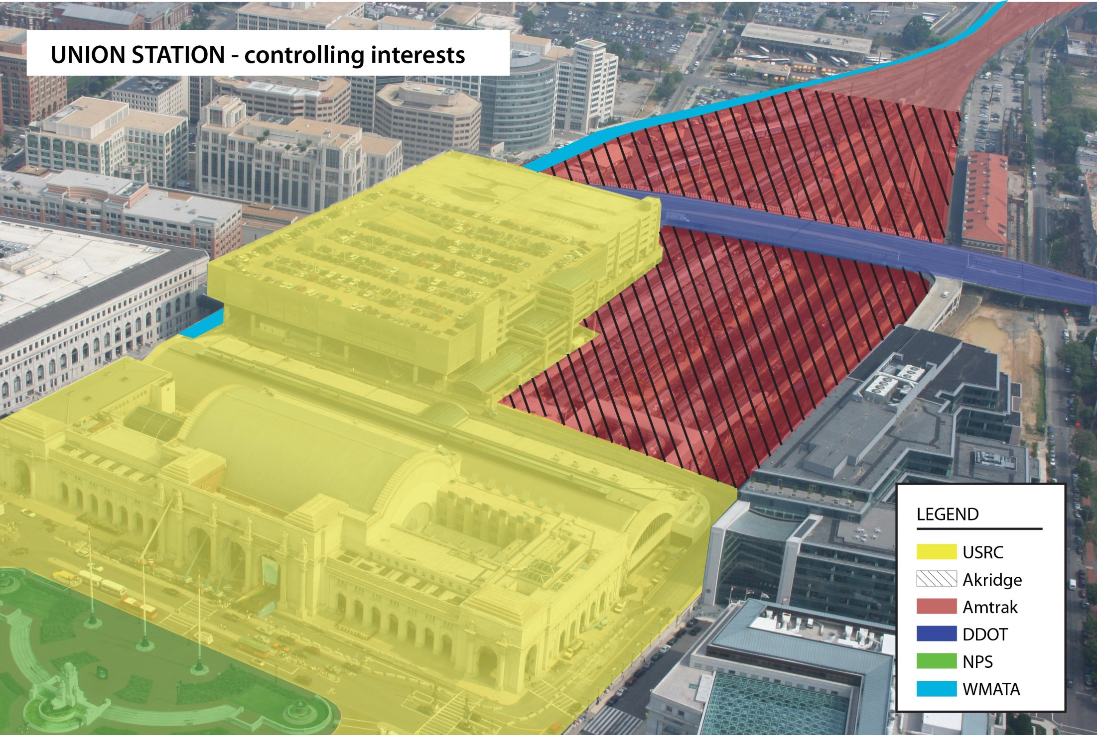
Controlling Interests

Slide 7
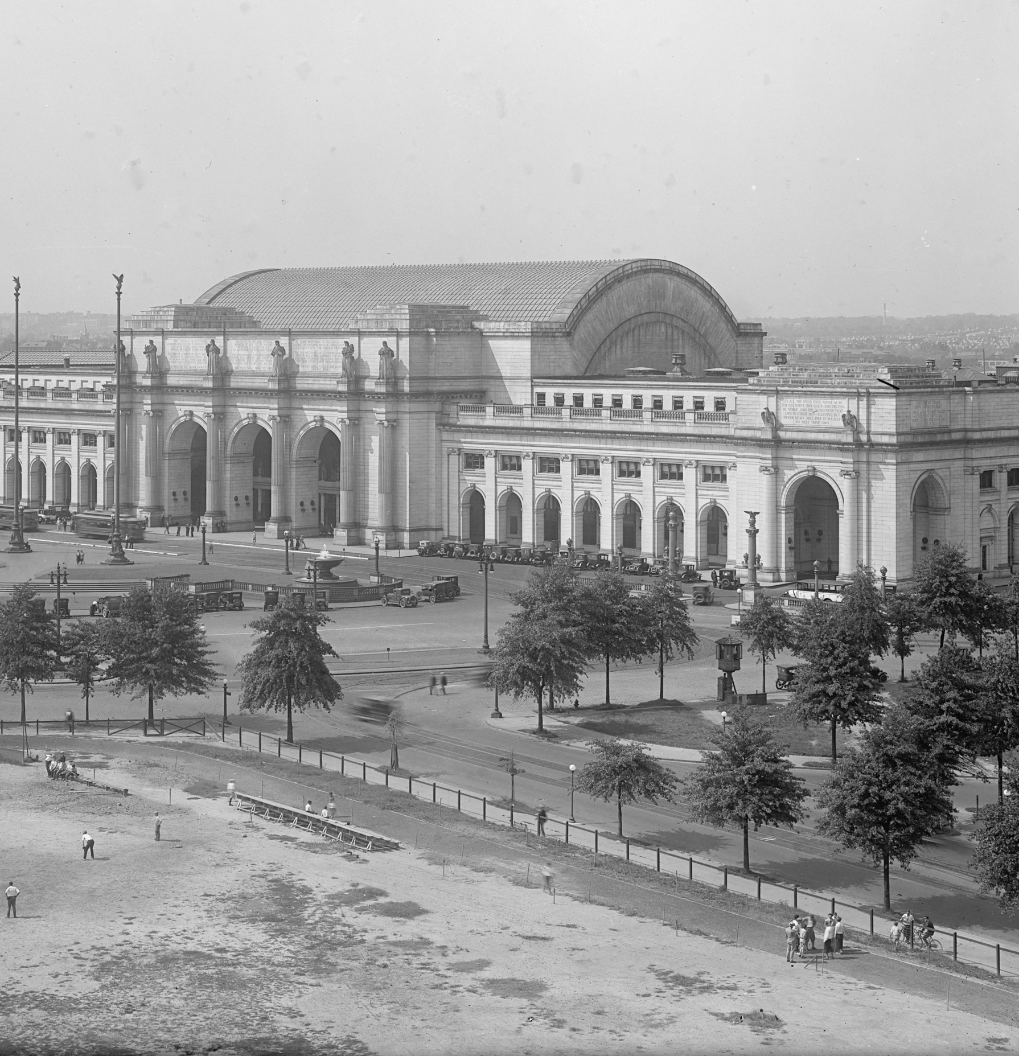
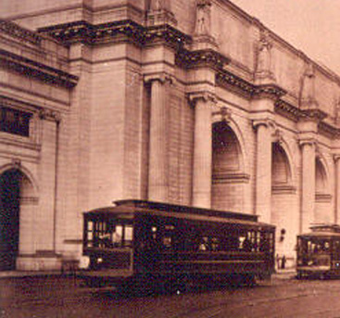
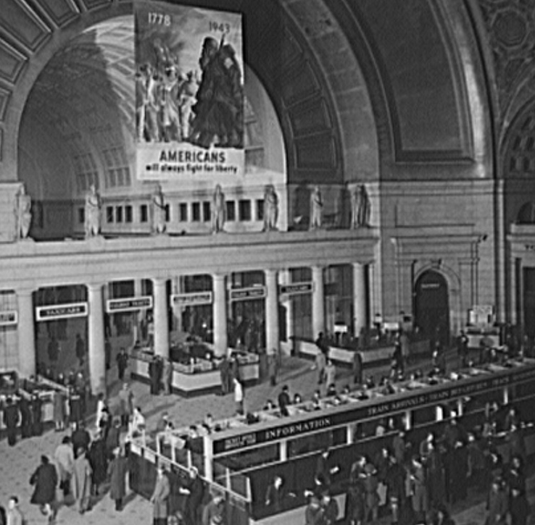
A Rich History
History of the Station
Station reached its peak in the 1940’s
Accommodating over 300 trains/day. Today the Station serves 200 trains/day.
Streetcar serviced the Station
Passengers waited in the Main Hall
Notes:
The Station’s reached it’s peak in the 1940’s.
Passengers waiting in the Main Hall
Streetcars bring passengers to the Station
World War II brought an influx of users to the Station, serving over 300 trains per day
Today the Station serves closer to 200 trains per day.

Slide 8
Union Station Today
Station Modes and Users
Rail (Amtrak, MARC, VRE)
Metrorail
Streetcar (coming 2014)
Intercity buses
Local buses
Regional commuter buses
Tour/Charter buses
University shuttle buses
Taxi (24/7)
Rental cars
2,300-spot parking garage
Bike rentals and storage
Retail and shopping
Function/event space
Amtrak corporate HQ
Amtrak package express
Tourists
37 Million Visitors Annually
Station handles 37 million visitors as compared to 22 million at Dulles – the region’s busiest airport.
#1 Metro Station for WMATA
(68,000 trips/day); #1 MARC Station
#2 Amtrak Station in the country; #2 VRE Station
2.6 Million riders/year on intercity buses alone
7 modes of transportation available;
Over 30 transportation providers to choose from
Notes:
What is Available at Union Station Today?
Hub of Regional, City and Neighborhood transportation
#2 Amtrak Station in the country
#1 Metro Station for WMATA (68,000 passengers/day)
#1 MARC Station
Station handles 32 million visitors as compared to: BWI – 22 million, Dulles – 23 million, Reagan– 19 million
7 modes of transportation available, with over 30 transportation providers to choose from

Slide 9
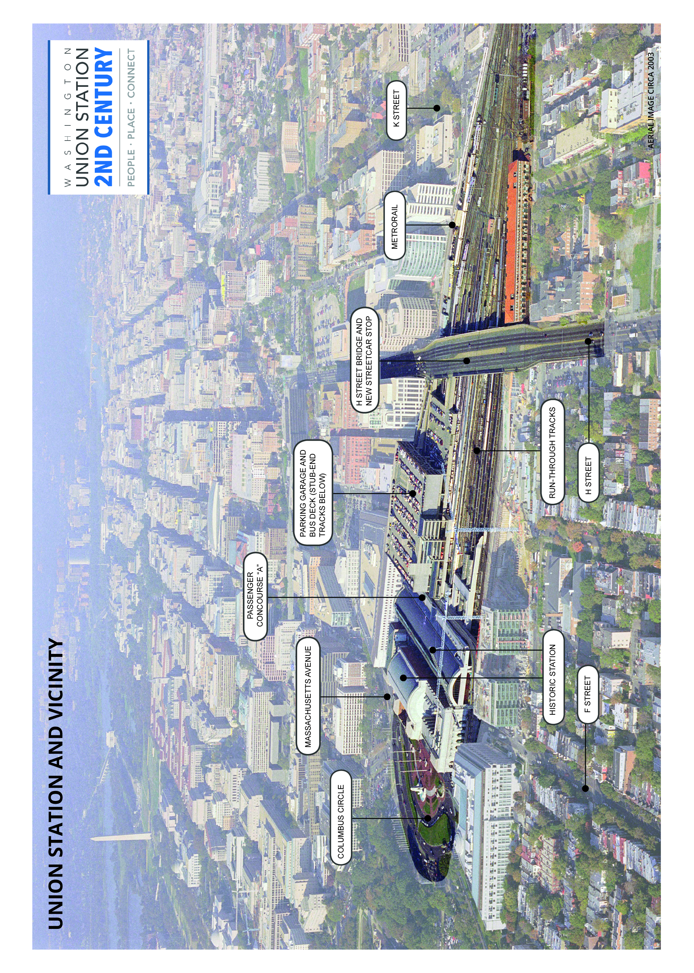
Existing Union Station Complex
PASSENGER
CONCOURSE “A”
MASSACHUSETTS AVENUE
PARKING GARAGE AND BUS DECK (STUB-END TRACKS BELOW)
COLUMBUS CIRCLE
H STREET BRIDGE AND NEW STREETCAR STOP
METRORAIL
K STREET
HISTORIC STATION
RUN-THROUGH TRACKS
F STREET
H STREET

Slide 10
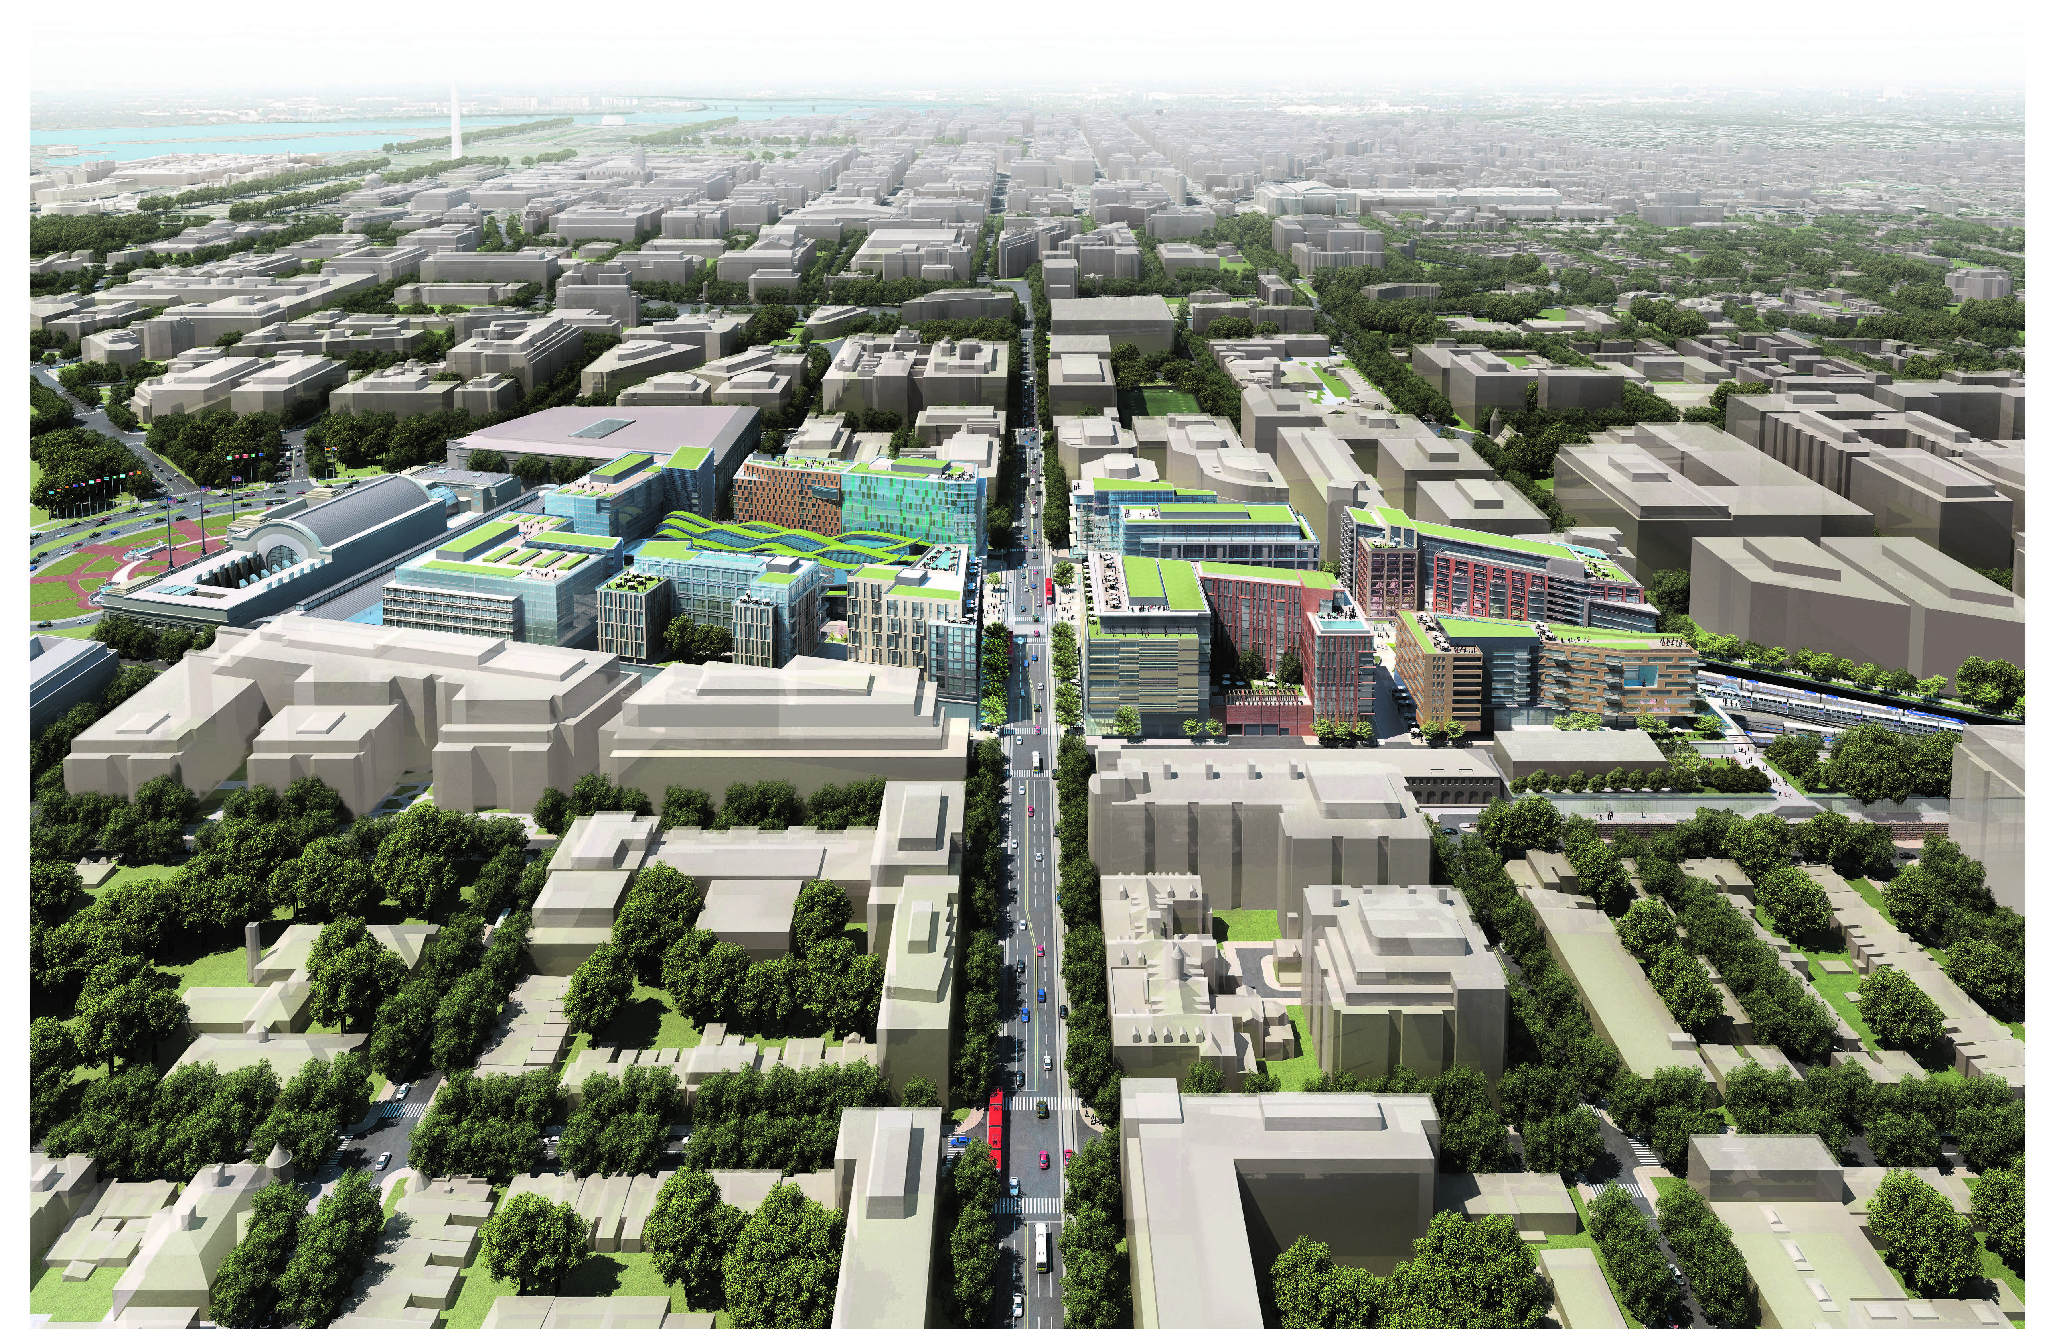
Future Vision
Create a world-class intermodal transportation hub
Match the quality and vision of the original, iconic station
Provide a gateway worthy of the Nation’s Capital
Create a new urban neighborhood in synergy with adjacent
community improvement efforts
Enhance regional connectivity

Slide 11
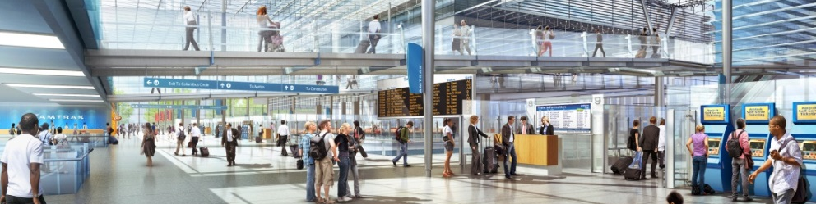
Project Quick Facts
Station expansion: Approx. 750,000 SF; $7.0B cost
Burnham Place: Approx. 3M SF; $1.5B cost
Rail ridership capacity increase: 3X
New station entrances: Approx. 14
New/Expanded concourses: 5
Economic Impact: $15B (preliminary estimate)
Intermodal Capacity: Integrated intercity and commuter rail, bus, taxi, streetcar, bicycle and parking

Slide 12
Washington Union Station’s 2nd Century
Intermodal Transportation Hub

Slide 13
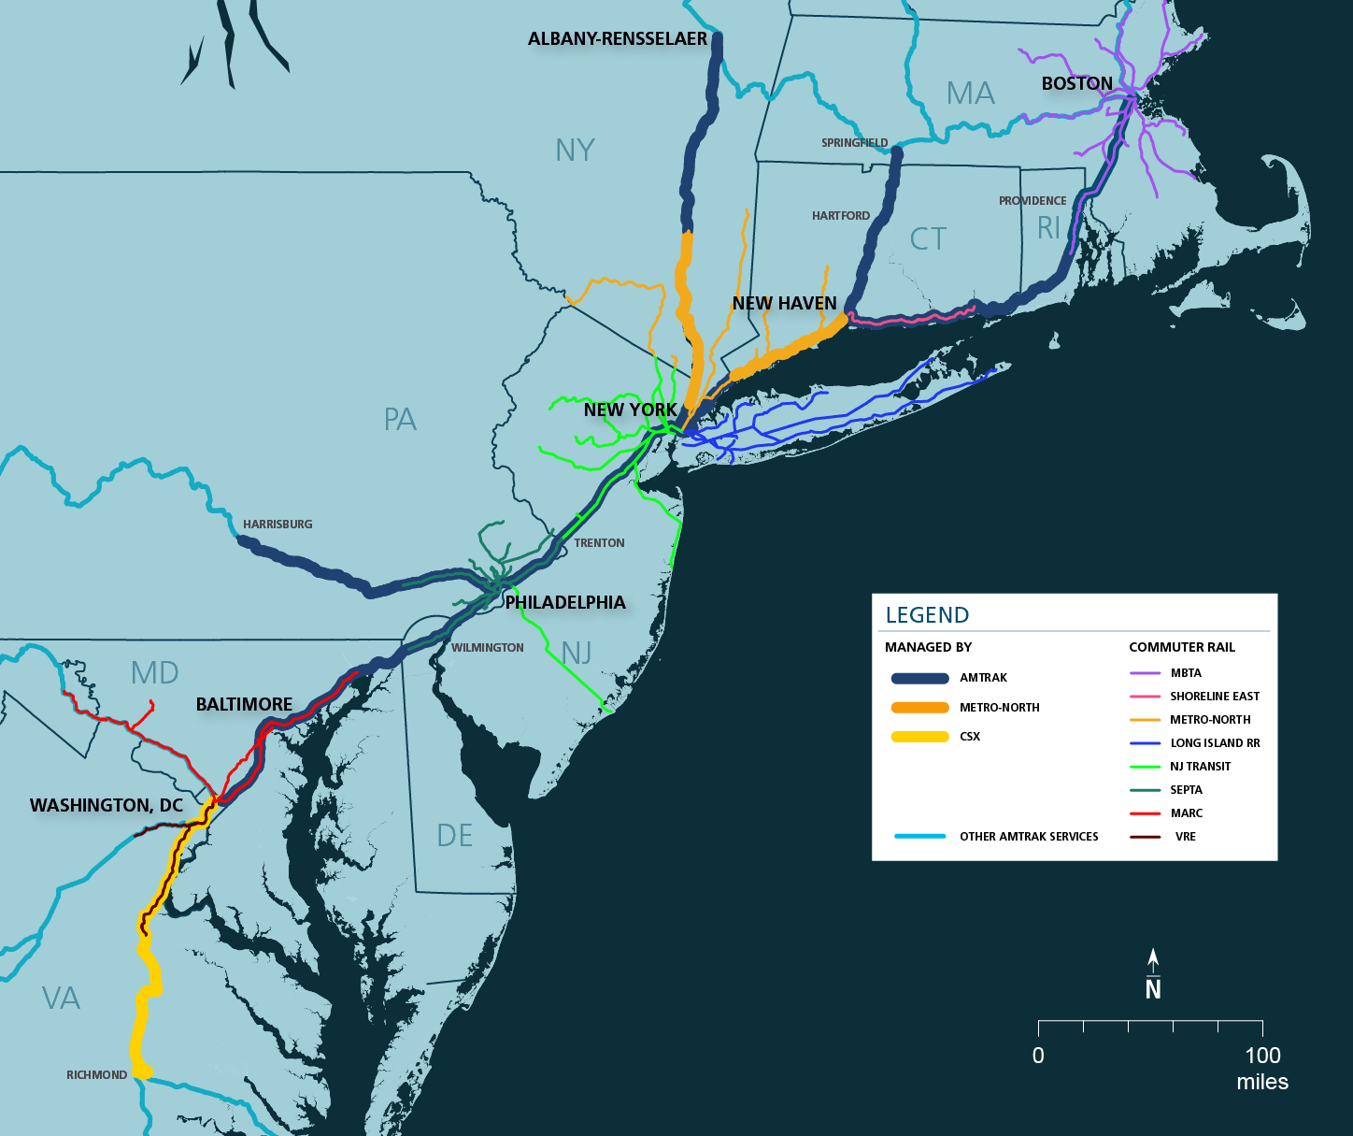
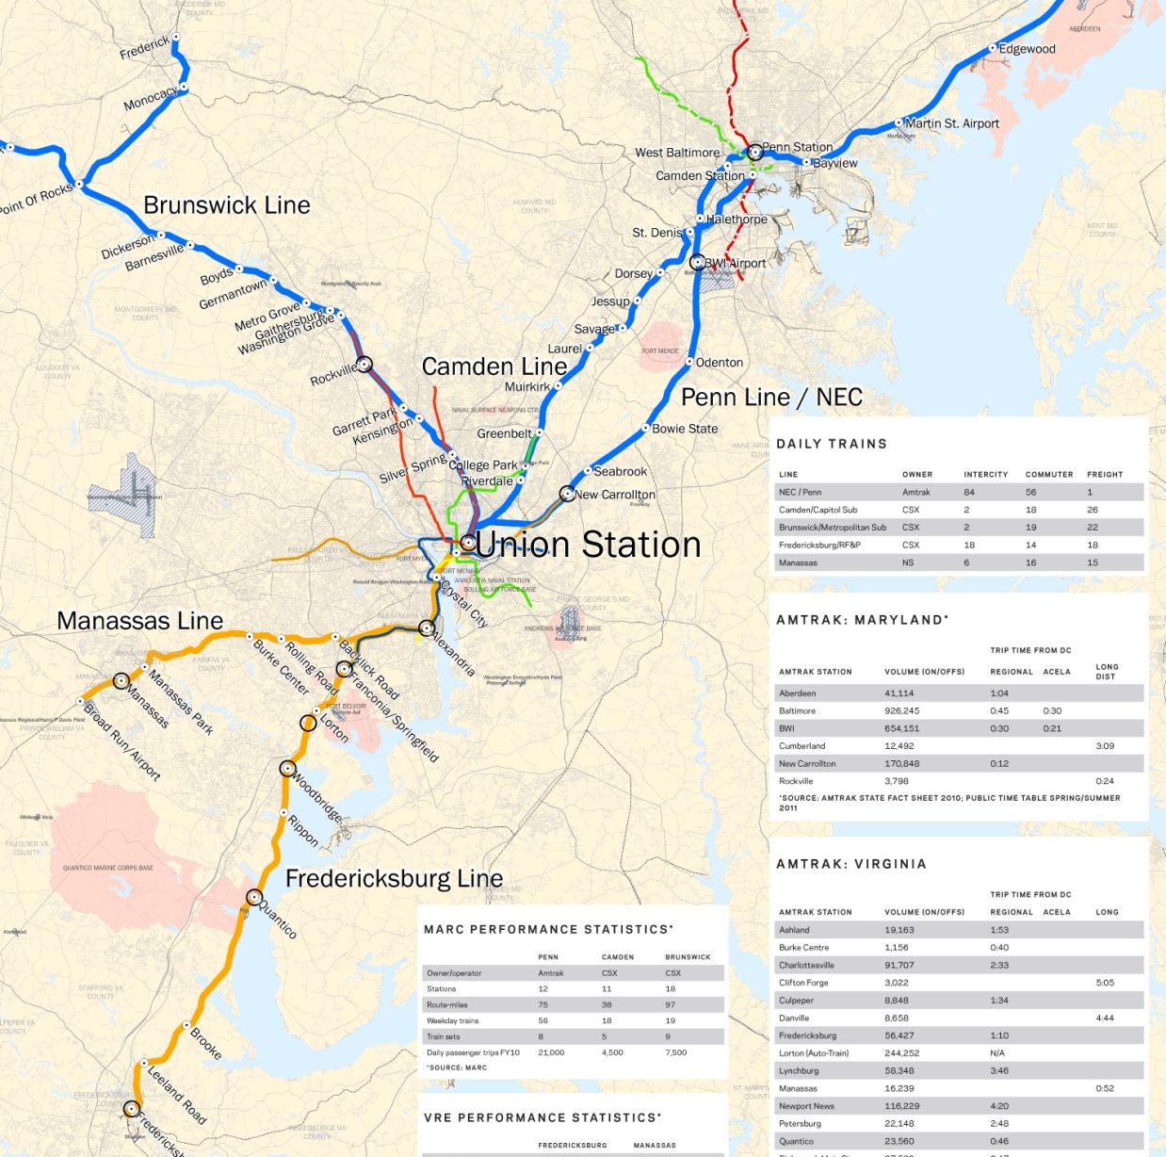
Invaluable Infrastructure
The nexus of the Mid-Atlantic’s transportation network, connecting MD, VA and D.C.
Southern anchor of the Northeast Corridor carrying 230 Million riders annually, 8 commuter lines and connecting a $2.6 Trillion economy.
Notes:
Union Station: fulcrum for expansion to commuter rail network, one of the enablers of thru-running for MARC and VRE
Critical anchor of the NEC and instrumental to unlocking capacity constraints along the entire Corridor

Slide 14
Why is this Project Critical?
Sustainable Future for Union Station
INCREASED DEMAND
Transportation demand continues to outpace population & job growth
LIMITED
NEW CAPACITY
Stations and rail infrastructure are operating at or near capacity
AGING INFRASTRUCTURE
Major structural components are operating on
century-old infrastructure
INCREASED CONGESTION
Highway and airport expansion not sufficient to absorb growth
Notes:
Increased Demand: transportation demand projections by 2040 – Commuter Rail Ridership +87%, Intercity Rail Ridership +115% on NEC
Increased Congestion/Limited New Capacity: Over 450 miles of I-95 projected to operating at 27mph or less without improvements by 2035; 5 NEC Airports will reach capacity by 2025 > all these have spillover impacts to NEC rail which is also operating near capacity

Slide 15
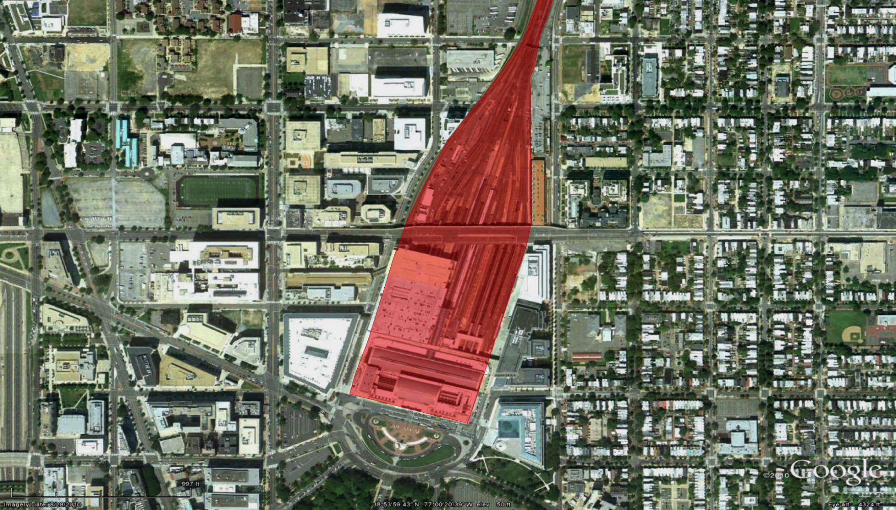
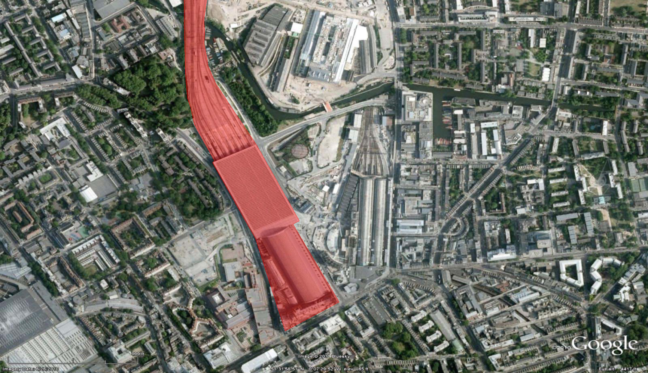
Optimizing Rail Operations
Optimize space for higher capacity – Within the same footprint, stations around the world are accommodating 3 to 10 times the number of passengers (commuter and intercity rail).
Washington Union Station
20 tracks | 57,000 daily passengers
St. Pancras Station, London
15 tracks | 167,000 daily passengers
Notes:
Within the the same footprint, stations around the world are pumping 3 to 10 times the number of passengers (commuter and intercity rail) that we are. These numbers do not include Metro.

Slide 16
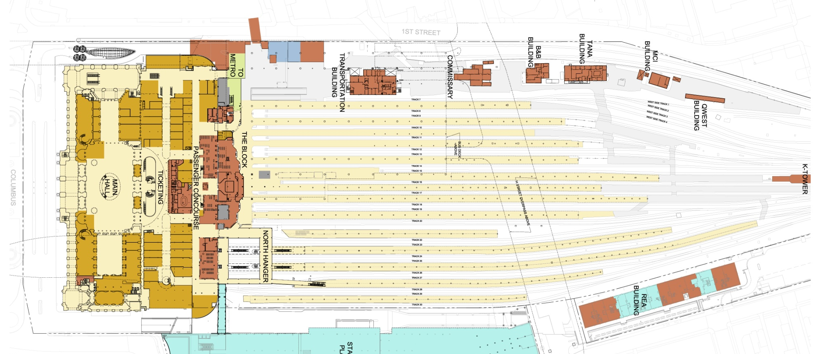
Existing Station Configuration
West Side Stub Tracks
EXISTING
PARKING
GARAGE
Main Concourse
East Side Run-Through Tracks

Slide 17
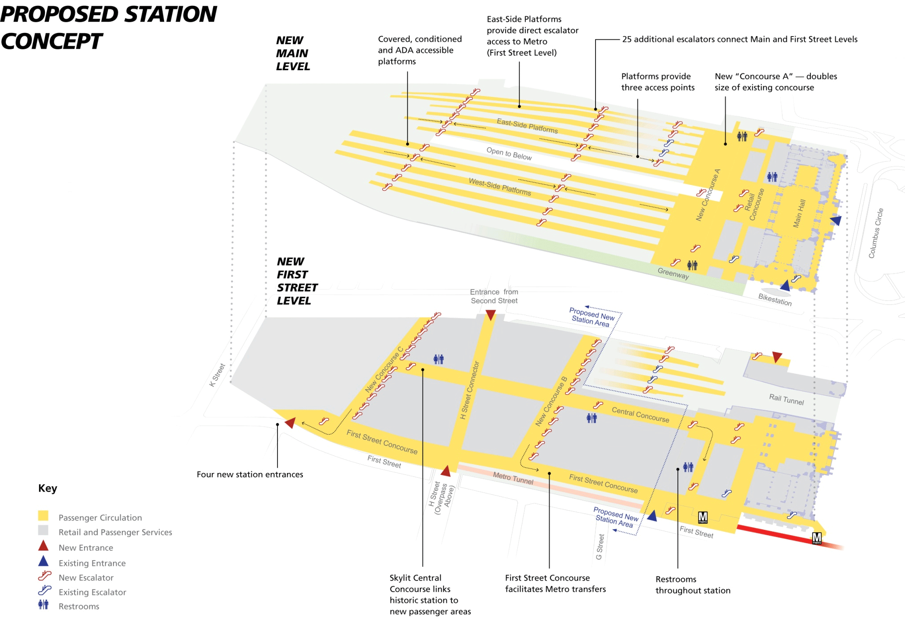
Unlocking Capacity
Notes:
Point out primary concept features:
4 new concourses below the existing track level
Approximately 8 new entrance/exit points connecting the station to neighboring economic nodes (NoMa)
Significant increase in vertical access points (elevators, escalators) to get people out quickly

Slide 18

Expanded Passenger Concourse
Notes:
Discuss concourse expansion and our near-term goals for immediate relief in Concourse A
Implement near-term projects to increase capacity, address existing deficiencies and improve the passenger experience
Reconfigure key support facilities to improve employee operational efficiencies and quality.

Slide 19
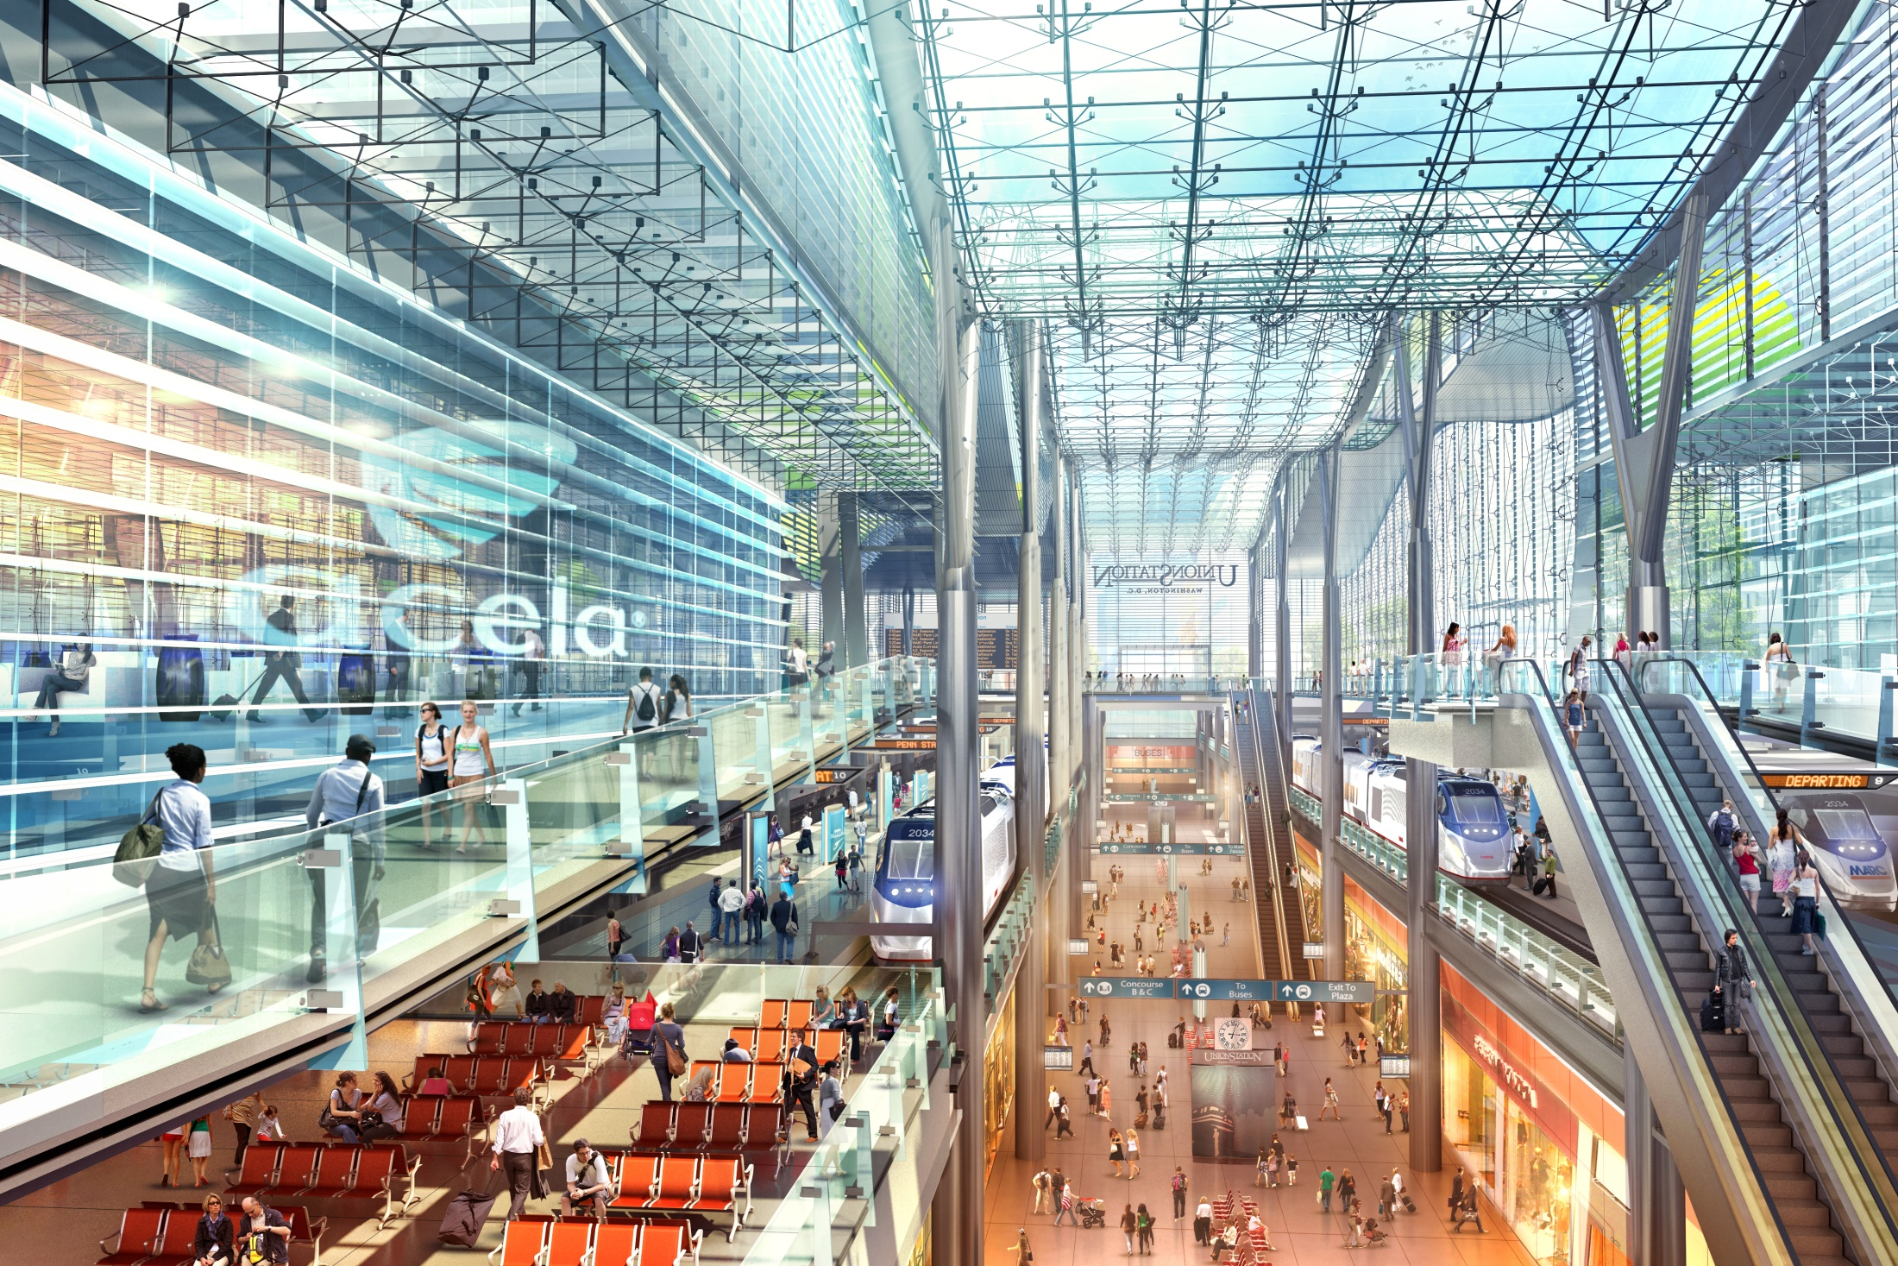
New Concourses & Train Shed
Two train hall renderings
Notes:
New Central concourse (below) with Train Hall roof above

Slide 20
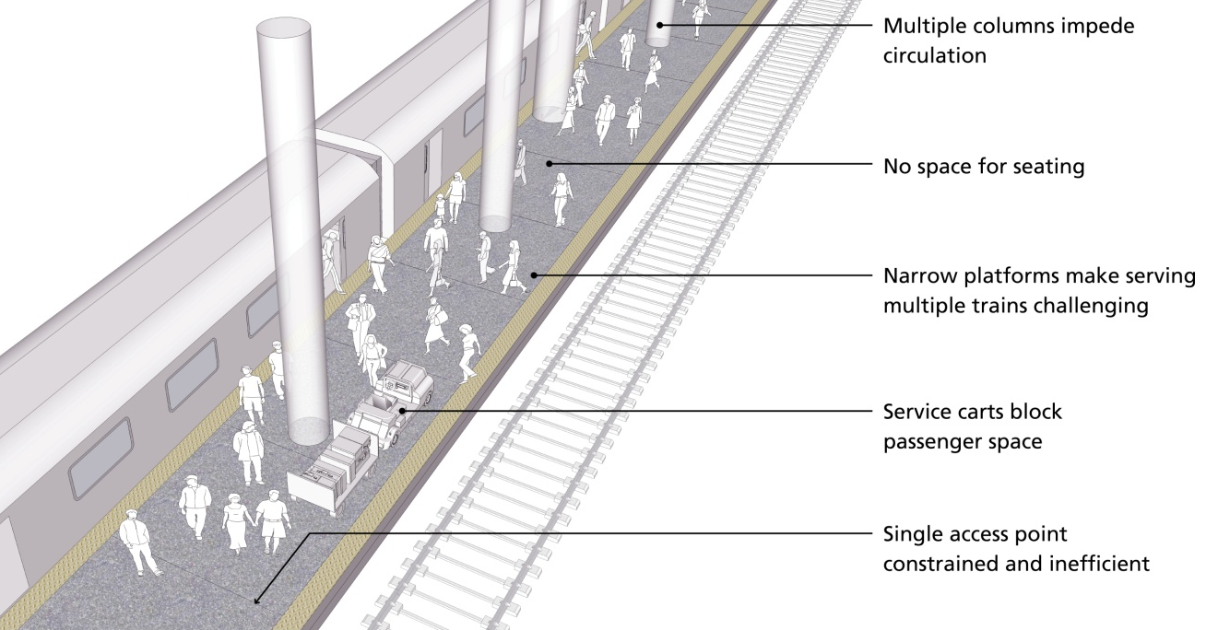
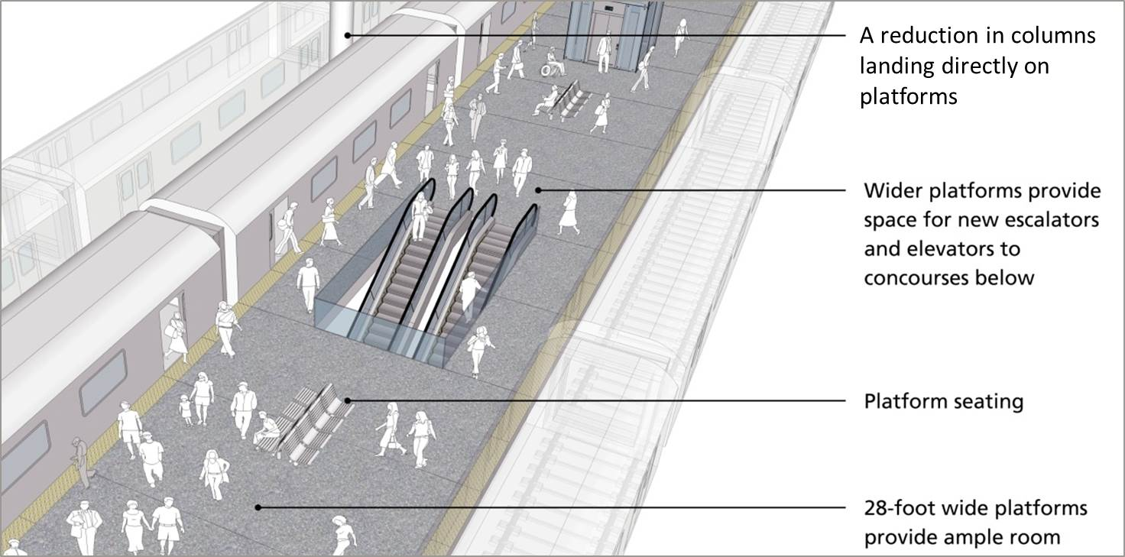
Existing
Expanded Platforms
Proposed

Slide 21
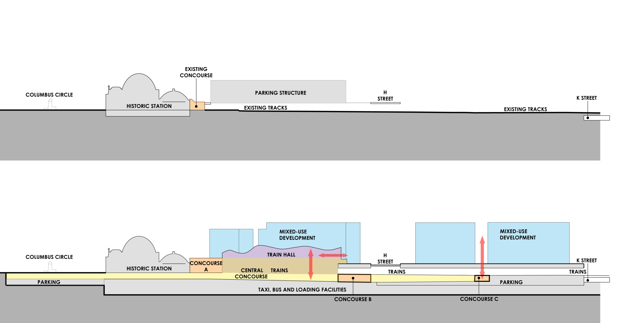
A New Intermodal Experience
Existing
Proposed
Notes:
Give wrap up of project…

Slide 22
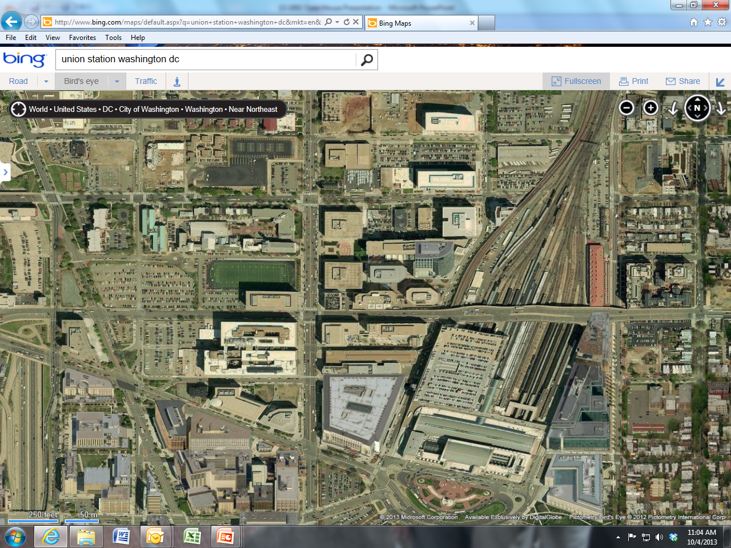
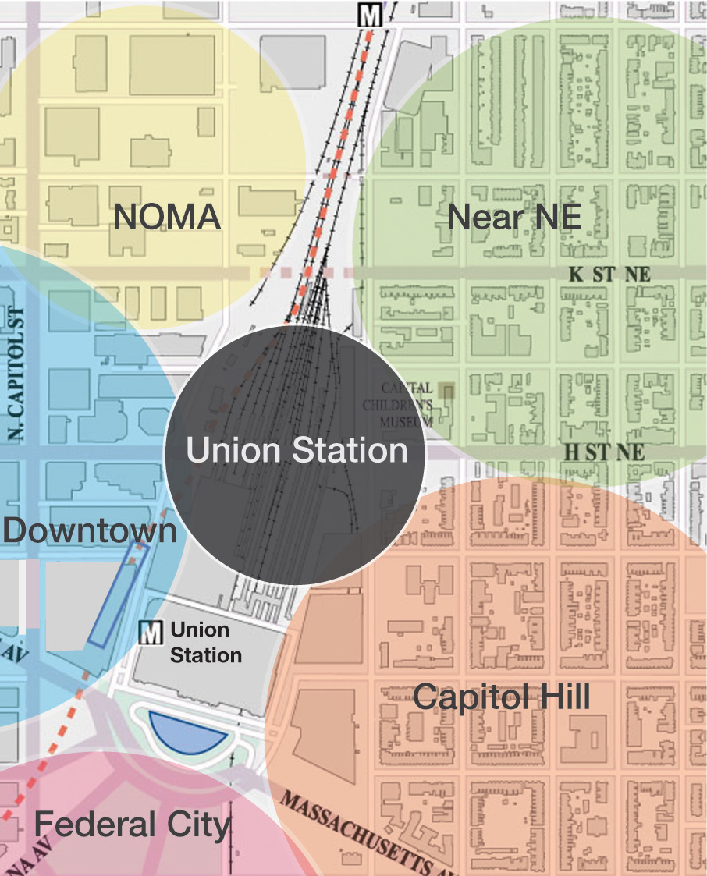
Reconnecting the City
NoMa
Union Station is situated in the epicenter of a significant trend of commercial revitalization

